Slide 1
Git
and other code archiving and versioning systems

Slide 2
Developer Driven Version Control
You join a tech startup and start writing specialized Python code for extracting and analyzing text from a large image databaase.
The general development team integrates your code into the application. Their lead developer is getting nervous that the code isn’t archived and versioned, and asks if you’d start tagging your code to match their release dates.

Slide 3
Code Sample Driven Version Control
You attend a software workshop, and a week later, you’re trying to remember the between “sep” and “collapse”. You type “what is the difference between sep and collapse?” into a search engine, and get this link:
https://gist.github.com/briandk/d9231ba1e2603eed0df1

Slide 4
Collaboration Driven Version Control
You attend a collaborative coding session for a natural language processing conference, and join a group of people experimenting with a library for word embeddings from Google Labs named “Bert”. Your group figures out a way to write code that may be promising for future research. How do you share, document, and archive the results?
https://github.com/geoffswc/Bert-TextXD

Slide 5
Collaboration Driven Version Control
A week later, you find a bug in the code, discover a more efficient way to use a library, or work out a technical issue that you weren’t able to solve during the session. You want to modify the code base, but you want keep the previous version to be available to your group. How can you share these results?

Slide 6
Publication Driven Version Control
You publish a paper (or tutorial, guide, how-to, on-line course) with text, code, graphics, and data, and you’d like to make it easier to reproduce.
https://www.theatlantic.com/science/archive/2018/04/the-scientific-paper-is-obsolete/556676/
https://github.com/jupyter/jupyter/wiki/A-gallery-of-interesting-Jupyter-Notebooks

Slide 7
Evolution of Version Control
Code archiving and versioning is used to:
discover code
share code
archive and backup code
version code
collaborate on code

Slide 8
and it doesn’t have to be code!

Slide 9
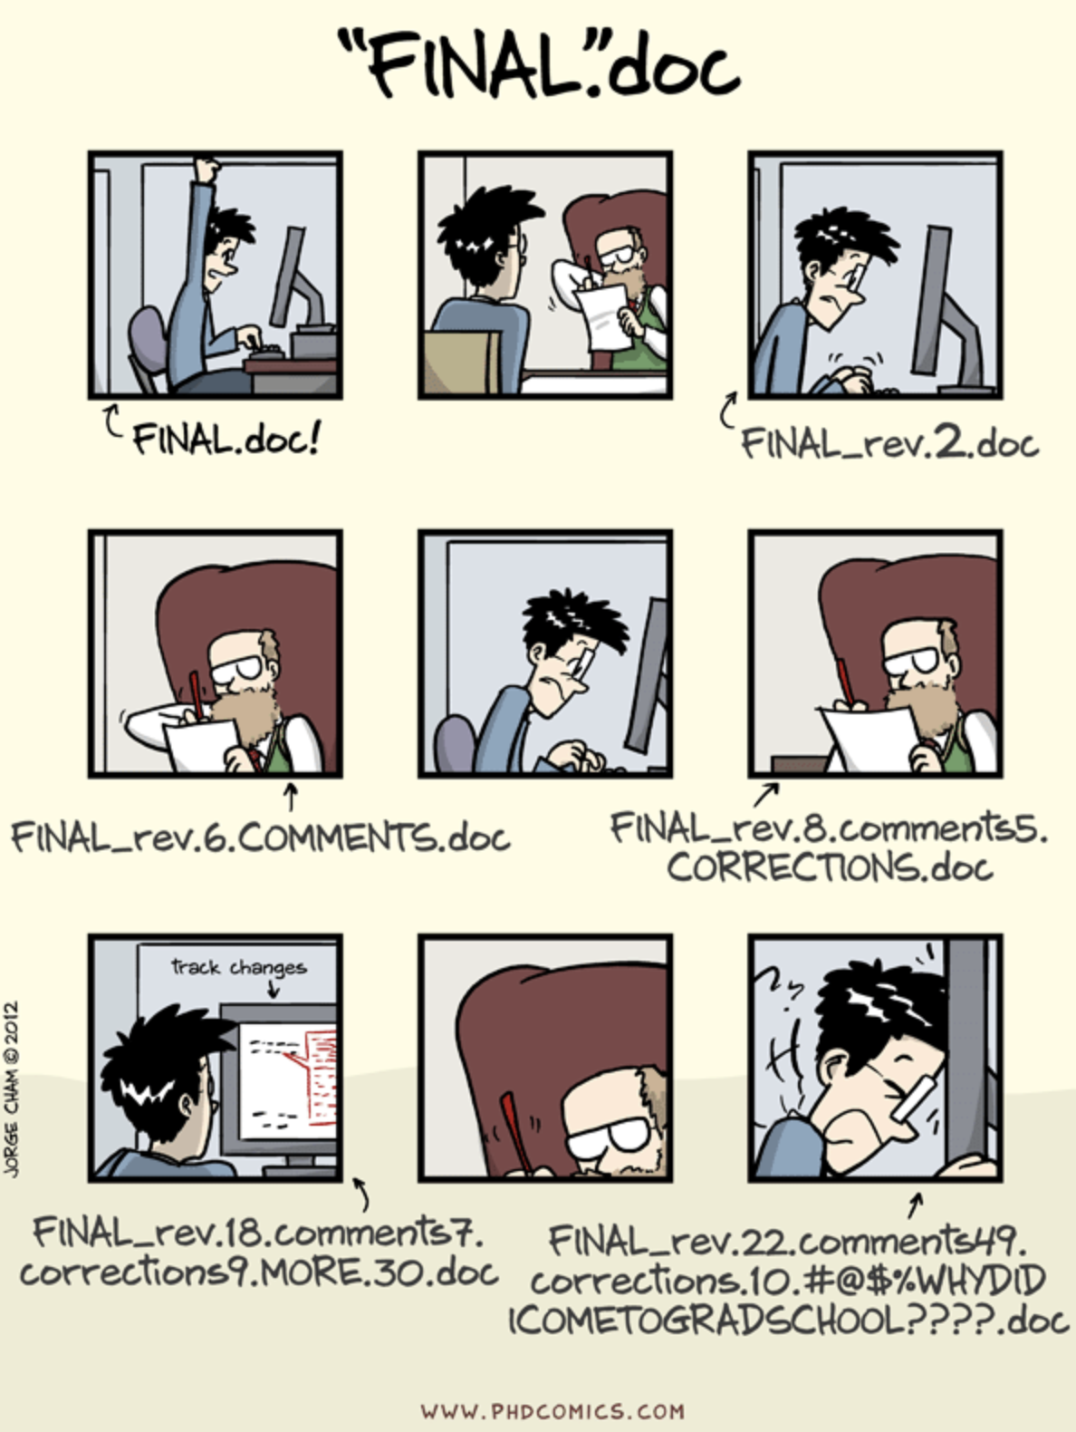

Slide 10
Set up git on your computer!
git config --global user.name “Geoffrey Boushey”
(no, this doesn’t need to match the github repo)
git config --global user.email “geoffrey.boushey@ucsf.edu”
(yes, this does need to match the github repo email)

Slide 11
Set up a Github Account
github.com

Slide 12
The Git Round Trip
git pull
git add
git commit
git push

Slide 13
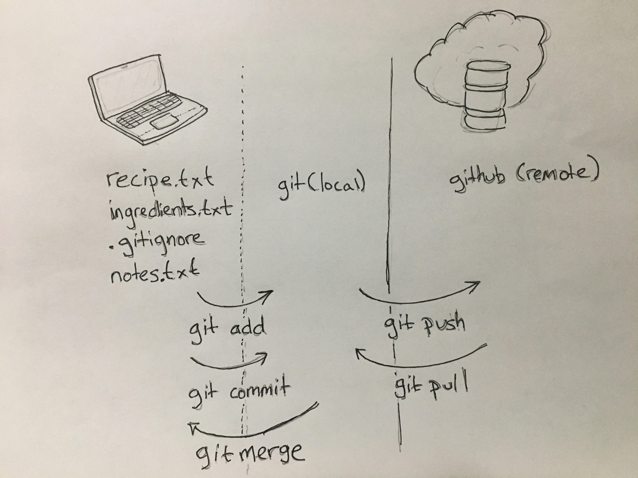

Slide 14
Leave things out
.gitignore

Slide 15
Collaborate

Slide 16
Collide
git merge

